Slide 1
Energy Systems Innovation Center (ESIC) Update April 2023
Mani V. Venkatasubramanian
Director, ESIC

Slide 2
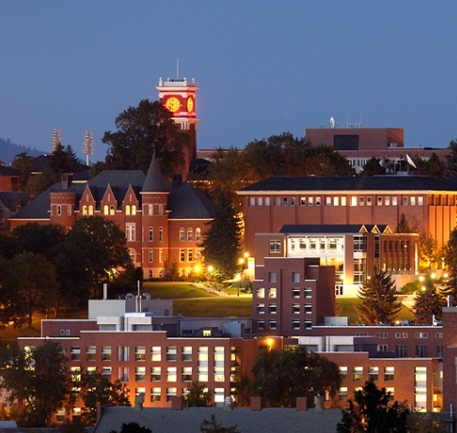
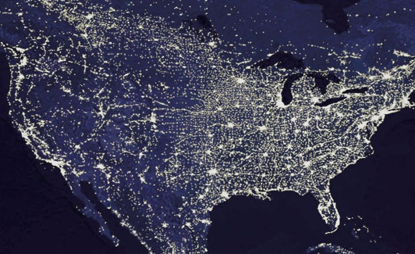
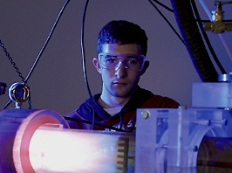
WSU Power Program
Power Professorship program since 1973
Energy Systems Innovation Center since 2012
Educating leaders in the industry
Partnering with industry and government
Significant & sustained impact
Premier power program
Image courtesy of NASA

Slide 3
Fall 2023 Event
Power Professorship program since 1973.
Attie Betts (Chairman of Electrical Engineering at WSU)
Wendell Satre (Washington Water Power Company)
Axel Strom (Grant County Public Utility District)
Celebrating 50 years of sustained support from the regional power industry.
Special events planned for the 2023 academic year.
Day event in Pullman on September 15, 2023 (home game on September 16, 2023).
Hotel rooms being held for Sept. 14th, 15th and 16th.
Details coming soon.
Contact linda.howell@wsu.edu.

Slide 4
Energy Systems Innovation Center
Vision
Leading the transition to affordable, sustainable and resilient electric power systems
Mission
Collaborative research, education, and outreach to solve challenges for modern power systems
Notes:
Power Program at WSU
A top program in US****
Leadership in research; well funded by government and industry
Significant and sustained impact on education
Educating leaders in industry****
Power professorship program since 1973
Professional services and conference activities

Slide 5
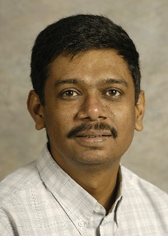
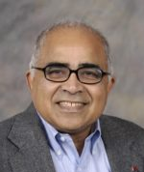
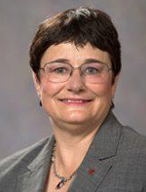
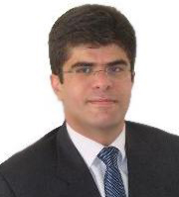
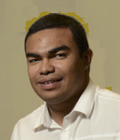
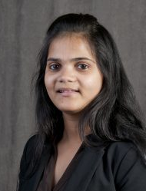
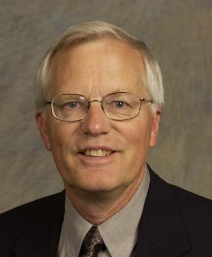
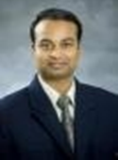
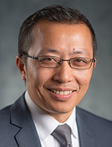
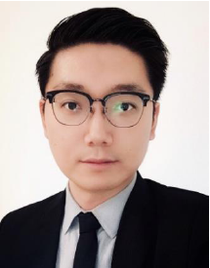
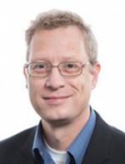
ESIC Power Faculty
Mani Venkatasubramanian, Director, Boeing Distinguished Professor
Anjan Bose, Regents Professor, Distinguished Professor in Power Engineering
Noel Schulz, Schweitzer Endowed Professor
Robert Olsen, Professor Emeritus
Saeed Lotfifard, Associate Professor
Anamika Dubey, Assistant Professor
Javier Guerrero, Clinical Assistant Professor
Shuzeng Xie, Clinical Assistant Professor
Josue Campos Do Prado, Assistant Professor
Hang Gao, Assistant Professor
Anurag Srivastava, Research Professor
Henry Huang, Research Professor
Kevin Schneider, Research Professor

Slide 6
ESIC Faculty in Allied Disciplines
Electrical Engineering
Sandip Roy – Dynamic Networks
Pat Pedrow – High Voltage
Hang Gao– WSU Vancouver
Xinghui Zhao – WSU Vancouver
Computer Science
Partha Pande – Network-on-Chip
Behrooz Shirazi – Pervasive Computing
Diane Cook – Smart Home/Environments
Jana Doppa – Machine Learning
Assefaw Gebremedhin – Data science
Ananth Kalyanaraman – Computing
Civil & Environmental
Michael Wolcott– Sustainable Infrastructures
Jennifer Adam – Water and Storage
John Petrie – Impact of Hydro Operations
Ji Yun Lee – Infrastructure resilience
Architecture
Todd Beyreuther – Integrated Design
Chemical Engineering
Su Ha – Fuel Cells
Economics
Alan Love – Electricity Markets
Communication
Amanda Boyd – Risk Communication
Mechanical & Materials Engineering
Jacob Leachman – Hydrogen/Nuclear
Dustin McLarty – Energy Storage
Grant Norton – Nanotechnology
Soumik Banerjee – Solar Cells, Batteries
Yuehe Lin – Batteries
Liberal Arts
Paul Whitney – Cognitive Behavior
Christine Horne – Social Norms

Slide 7
New ESIC faculty
Ongoing faculty search:
(Assistant/Associate/Full Professor level)
Power Electronics
Power Systems
Cybersecurity (multiple)

Slide 8
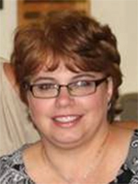
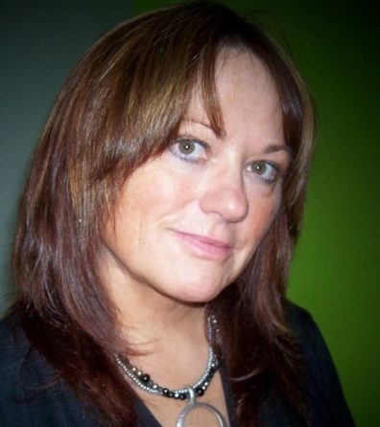
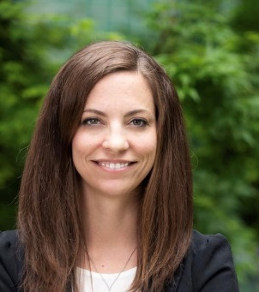
ESIC Staff
Jeannine Burke – Manager
Linda Howell – Industry Relations Coordinator (2023 VCEA Staff Excellence Award)
Darlene Miller – Research Administrator
Tiffani Stubblefield – UI Assist Coordinator
Samantha Ulam – Communications Assistant

Slide 9
Students 2021-2022
Ph.D. Students: 26
M.S.: 3 (Thesis) + 2 (Non-Thesis)
Seniors taking power electives: 30

Slide 10
Research Expenditures
$M

Slide 11
ESIC Thrust Areas
1) Microgrids and IBRs
2) Reliability and Resilience
3) Grid Edge/Privacy/Cybersecurity
4) AI and ML Applications
5) Workforce 2.0

Slide 12
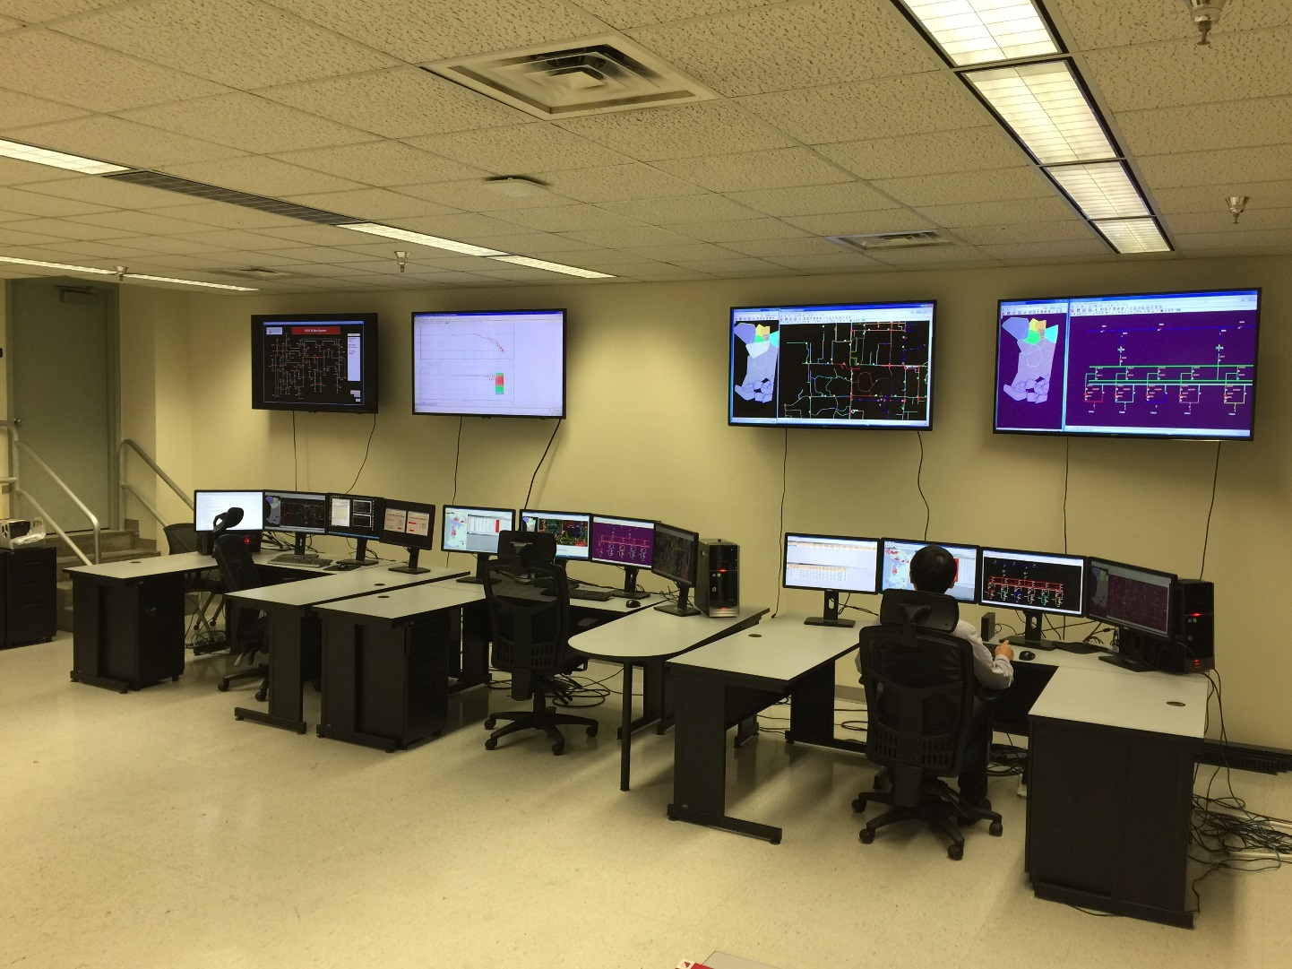
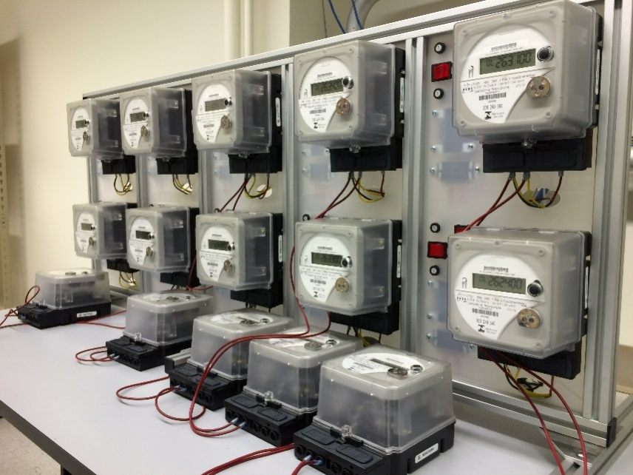
WSU Smart City Testbed

Slide 13
72 kW PV System (State of WA and DoE)
WSU Research and Technology Park, Pullman

Slide 14
ESIC Outreach
Technical conferences: WPRC, ESIC Summit.
ESIC Seminars (weekly)
ESIC Scholarships
Leadership in professional societies
Technology transfer – start-up companies and technology licensing
Collaboration with centers, e.g. AGI, PSERC, CHARGE.

Slide 15
ESIC Memberships
ESIC Power Education Partnership (PEP)
Supporting power engineering education
ESIC Research Excellence Partnership (REP)
Promoting research collaborations

Slide 16
ESIC PEP Membership
ESIC Power Education Partnership (PEP)
Annual Membership: Varies
Benefits – Support Power Engineering Education
Practicum
Support for Internships/Jobs
Power Curriculum Feedback
Free booths at Fall Career Expo and IEEE Career Fair
Professional Development Hours for ESIC weekly seminars
Optional Tutorials by Faculty Experts
Dedicated Industry Liaison

Slide 17
ESIC PEP Membership
ESIC PEP Members
2020-21

Slide 18
ESIC REP Membership
ESIC Research Excellence Partnership (REP)
Annual Membership: $15K
Benefits - Access to ESIC research:
Research collaborations
ESIC weekly seminars
Project catalog/announcements
Research reports and papers on secure website
Invitation to be project advisors
Tutorials by faculty experts
ESIC Summit
Dedicated industry liaison
Seed projects at no overhead (no deliverables)

Slide 19
ESIC REP Membership
ESIC REP
Members 2020-21

Slide 20
PSM in Electrical Power Engineering
Professional Science Masters (PSM) in Electrical Power Engineering (EPE)
Online degree program offered by ESIC
Combination of Electrical Engineering and Engineering Management courses
Students from all over the world

