Slide 1


Current Research Summary
Mani V. Venkatasubramanian
Boeing Distinguished Professor of Electrical Engineering

Slide 2
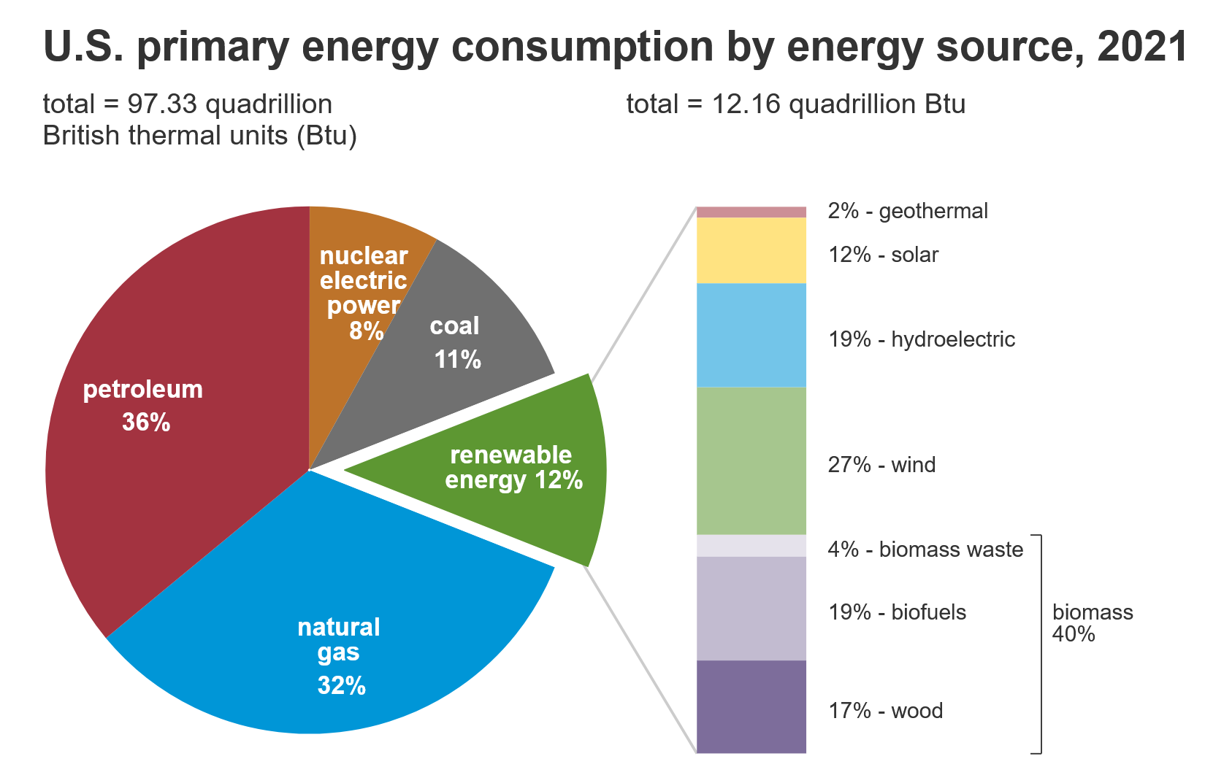
Sustainable Energy Sources
Fossil fuels make up 79% of total energy consumed in 2021.
All sustainable energy sources of the future are tied to the power grid.
Source: eia.gov

Slide 3
Oscillation Monitoring
Unusual operating conditions leading to lower damping levels of inter-area modes (0.1 Hz to 0.8 Hz).
Forced oscillations interacting with inter-area modes causing interconnection-wide oscillations.
Subsynchronous oscillations (5 Hz to 20 Hz) related to power electronic controls of IBRs.
Measurement-based tools.
Operator tools for RTE, France, and PSERC.
Source location, SEL.
Visualization (SEL Synchrowave), SDG&E.

Slide 4
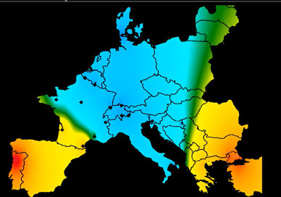
Oscillation Stability Controls
How to improve the damping of interarea modes?
Interconnection Dynamic Models not representative.
Mode properties can change depending on system conditions.
Online methods for input-output model estimation and adaptive control designs
Probing signals?
HVDC modulation designs.
East- Center- West European Inter-area mode
Damping can be low.

Slide 5
Analysis of IBR Models
May 9, 2021 Texas Odessa Event
(1100 MW solar trip)
(NERC Report)
What IBR model parameters are critical in influencing bulk power system performance?
What IBR parameters can be estimated/validated from terminal measurements?
What measurements and events are useful?

Slide 6
Model Validation Toolbox
Power plant model validation now widely accepted by industry - Need to make the process more user friendly.
Open-source model validation toolbox in this project using RTE Dynawo open-source transient stability simulation engine.
Efficient algorithms. User interface.
Synchronous machines and IBR plants.

