Slide 1


Energy Systems Innovation Center (ESIC)
Mani V. Venkatasubramanian
Director, ESIC

Slide 2

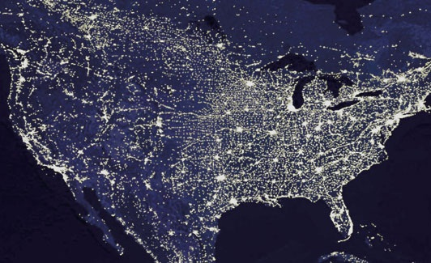
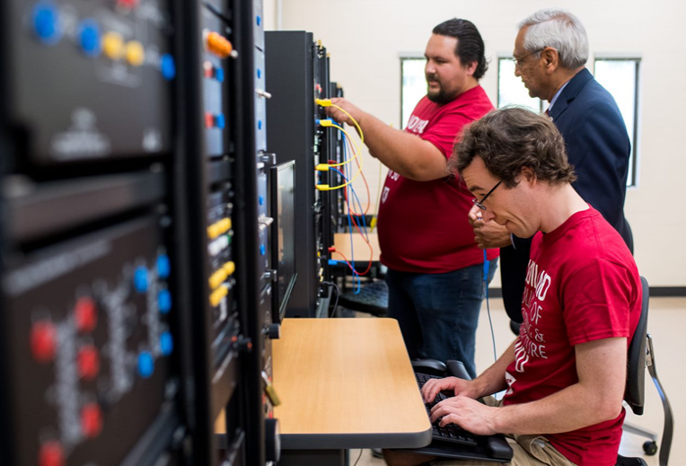

WSU Power Program
Power Professorship program since 1973
Energy Systems Innovation Center since 2012
Educating leaders in industry
Partnering with industry and government
Significant & sustained impact
Premier power program
Image courtesy of NASA

Slide 3
Energy Systems Innovation Center
Vision
Leading the transition to affordable, sustainable and resilient electric power systems
Mission
Collaborative research, education, and outreach to solve challenges for modern power systems
Notes:
Power Program at WSU
A top program in US****
Leadership in research; well funded by government and industry
Significant and sustained impact on education
Educating leaders in industry****
Power professorship program since 1973
Professional services and conference activities

Slide 4
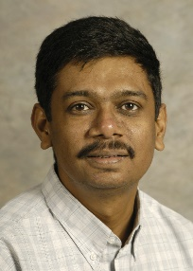
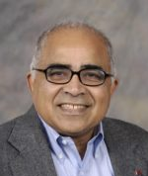
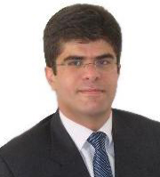
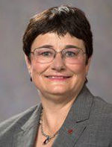
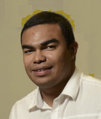
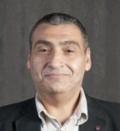
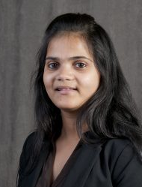
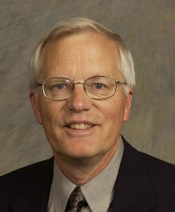
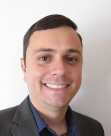
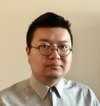

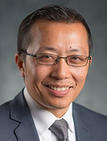
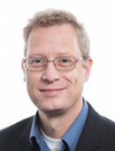
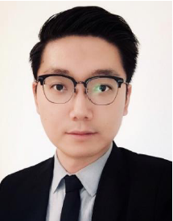
ESIC Power Faculty
Mani Venkatasubramanian, Director, Boeing Distinguished Professor
Anjan Bose, Regents Professor, Distinguished Professor in Power Engineering
Noel Schulz, Schweitzer Endowed Professor
Robert Olsen, Professor Emeritus
Saeed Lotfifard, Associate Professor
Anamika Dubey, Assistant Professor
Ahmed Abu-Hajar, Clinical Associate Professor
Javier Guerrero, Clinical Assistant Professor
Shuzeng Xie, Clinical Assistant Professor
Anurag Srivastava, Research Professor
Josue Campos Do Prado, Assistant Professor
Hang Gao, Assistant Professor
Henry Huang, Research Professor
Kevin Schneider, Research Professor

Slide 5

ESIC Faculty in Allied Disciplines
Electrical Engineering
Sandip Roy – Dynamic Networks
Pat Pedrow – High Voltage
Hang Gao– WSU Vancouver
Xinghui Zhao – WSU Vancouver
Computer Science
Partha Pande – Network-on-Chip
Behrooz Shirazi – Pervasive Computing
Diane Cook – Smart Home/Environments
Jana Doppa – Machine Learning
Assefaw Gebremedhin – Data science
Ananth Kalyanaraman – Computing
Civil & Environmental
Michael Wolcott– Sustainable Infrastructures
Jennifer Adam – Water and Storage
John Petrie – Impact of Hydro Operations
Ji Yun Lee – Infrastructure resilience
Architecture
Todd Beyreuther – Integrated Design
Chemical Engineering
Su Ha – Fuel Cells
Economics
Alan Love – Electricity Markets
Communication
Amanda Boyd – Risk Communication
Mechanical & Materials Engineering
Jacob Leachman – Hydrogen/Nuclear
Dustin McLarty – Energy Storage
Grant Norton – Nanotechnology
Soumik Banerjee – Solar Cells, Batteries
Yuehe Lin – Batteries
Liberal Arts
Paul Whitney – Cognitive Behavior
Christine Horne – Social Norms
5

Slide 6
New ESIC faculty
Ongoing faculty search for three positions:
(Assistant/Associate/Full Professor level)
Power electronics
Cybersecurity
Power systems including AI/ML applications

Slide 7
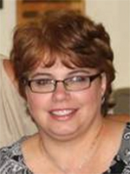
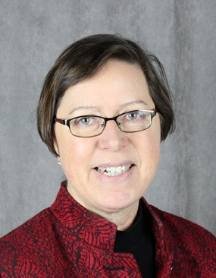
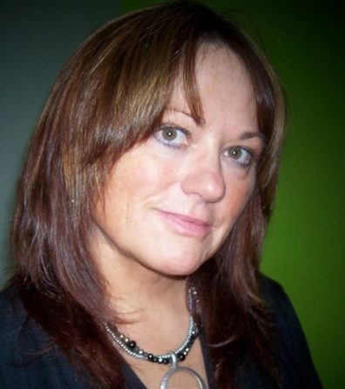

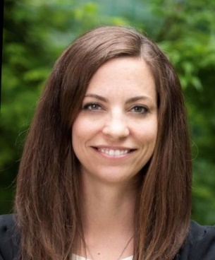
ESIC Staff
Jeannine Burke – Manager
Linda Howell – Industry Relations Coordinator
Darlene Miller – Research Administrator
Tiffani Stubblefield – UI Assist Coordinator
Samantha Ulam – Communications Assistant

Slide 8
Students 2020-2001
Ph.D. Students: 21
M.S.: 2 (Thesis) + 4 (Non-Thesis)
Seniors: 25

Slide 9
Research Expenditures
$M

Slide 10
ESIC Thrust Areas
1) Microgrids and IBRs
2) Reliability and Resilience
3) Grid Edge/Privacy/Cybersecurity
4) AI and ML Applications
5) Workforce 2.0

Slide 11
ESIC Memberships
ESIC Power Education Partnership (PEP)
  Supporting power engineering education
ESIC Research Excellence Partnership (REP)
  Promoting research collaborations

Slide 12
ESIC PEP Membership
ESIC Power Education Partnership (PEP)
Annual Membership: Varies
Benefits – Support Power Engineering Education
    Practicum
    Support for Internships/Jobs
    Power Curriculum Feedback
    Free booths at Fall Career Expo and IEEE Career Fair
    Professional Development Hours for ESIC weekly seminars
    Optional Tutorials by Faculty Experts
    Dedicated Industry Liaison

Slide 13










ESIC PEP Membership
ESIC PEP Members
2020-21

Slide 14
ESIC REP Membership
ESIC Research Excellence Partnership (REP)
Annual Membership: $15K
Benefits - Access to ESIC research:
    Research collaborations
    ESIC weekly seminars
    Project catalog/announcements
    Research reports and papers on secure website
    Invitation to be project advisors
    Tutorials by faculty experts
    ESIC Summit
    Dedicated industry liaison
    Seed projects at no overhead (no deliverables)

Slide 15





ESIC REP Membership
ESIC REP
Members 2020-21

Slide 16
PSM in Electrical Power Engineering
Professional Science Masters (PSM) in Electrical Power Engineering (EPE)
Online degree program offered by ESIC
Combination of Electrical Engineering and Engineering Management courses
Students from all over the world

Slide 17
Hydrogen Hub Update
Dr. Aaron Feaver (CHARGE)

Slide 18
Industry Perspectives
Avista
GE Renewables Grid LLC
Pacific Northwest National Laboratory
    Carl Imhoff
Portland General Electric
    James Landstrom
Puget Sound Energy
    David Landers
Schweitzer Engineering Laboratories
Snohomish PUD
    John Heib

Slide 19
Research Overview by ESIC Faculty
Dr. Anjan Bose
Dr. Anamika Dubey
Dr. Saeed Lotfifard
Dr. Mani Venkatasubramanian
Dr. Bob Olsen
Dr. Sanjeev Pannala
Dr. Assefaw Gebremedhin

Slide 20
Cosimulation, Clean Energy and Decarbonization
Anjan Bose
HELICS+ (funded by PNNL)
  Use cases – Transactive control
  Communications simulation
CEF-2 and CEF-3 (funded by Avista)
  University district feeder control
  Morris Plant control of both electric and thermal loads
Grid transformation (unfunded fun)
  Decarbonization
  Reliability/resiliency

Slide 21
Active Power Distribution Systems
PI: Dr. Anamika Dubey
Changing nature and requirements of the grid at the edge interfacing:
Most of the changes at MV/LV power distribution level (at the grid-edge interfacing)
Effectively leverage the grid-edge resources to ensure efficient, resilient and reliable grid operations
Serious challenges to planning and operation of the power systems including on the reliability and stability of bulk power systems

Slide 22
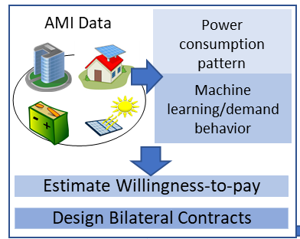
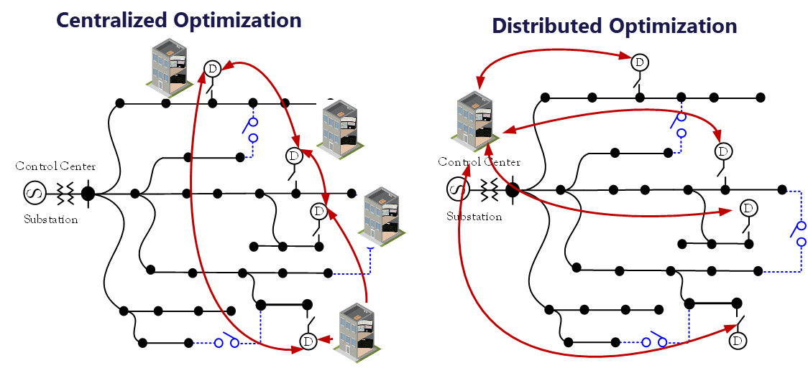
Control and Optimization: Active Power Distribution Systems
PI: Dr. Anamika Dubey
Funded by Pacific Northwest National Lab and Department of Energy, (GridAPPS-D, CITADELS, GDTAF), National Science Foundation (Cyber-physical System), Schweitzer Engineering Laboratories, Avista Corp. (DOE Connected Community)
Coordinate grid-edge devices by integrating data, measurement, and control to optimize distribution operations for grid services
Flexible load models
Aggregation of demand-side flexibility
Market coordination
Distribution Grid Optimization at-the-edge-interfacing
Algorithmic bottlenecks
Ownership boundaries and privacy concerns
Information unavailability and uncertainty
Visibility and situational awareness
Layered coordination architecture for distributed applications

Slide 23
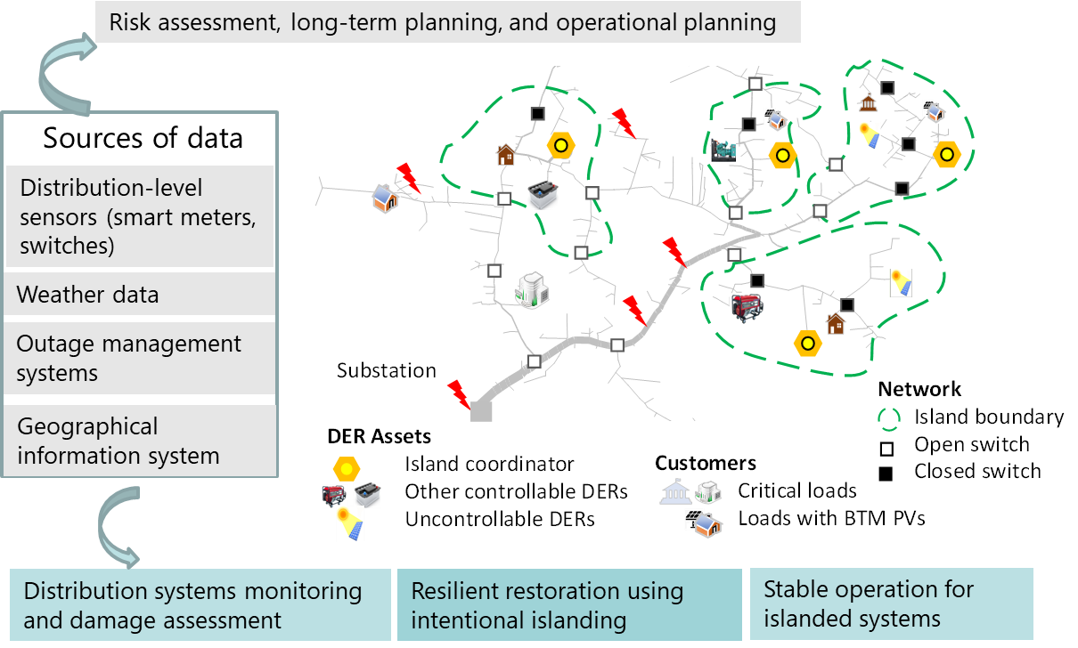
Operational Resilience to High-Impact Low-Probability Events
PI: Dr. Anamika Dubey
Funded by National Science Foundation (CAREER), Pacific Northwest National Labs and Department of Energy (CITADELS)
Operational Resilience to High-Impact Low-Probability Events (Fire-related damages, extreme cold or intense heat waves, storms)
Risk Modeling for High-impact low probability events, and risk-averse optimization
Non-traditional ways of operating grid: Microgrid and network of microgrid to support critical loads, Planned rolling/rotating blackouts
Long-term and operational planning for resilience and evaluation of cost-benefit tradeoffs.

Slide 24
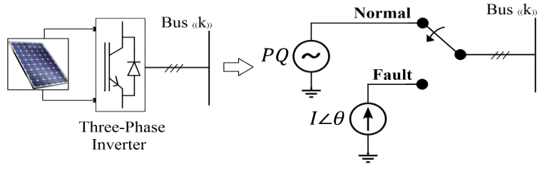
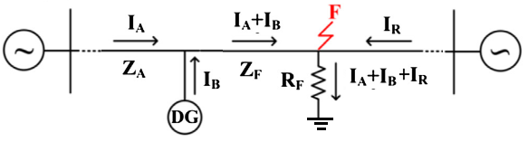

Virtual Meter for Active Distribution Systems
Funded by DOE, 2020-2023
WSU-PI: Saeed Lotfifard (Subcontract from Georgia Tech)
This project will develop protection, fault location identification and system restoration methods for active distribution systems with large integration of inverter-based sources

Slide 25
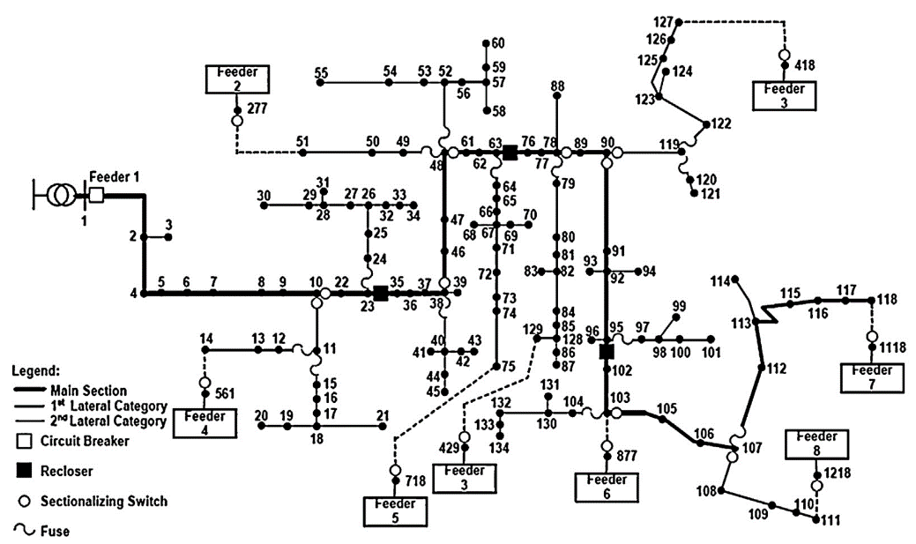
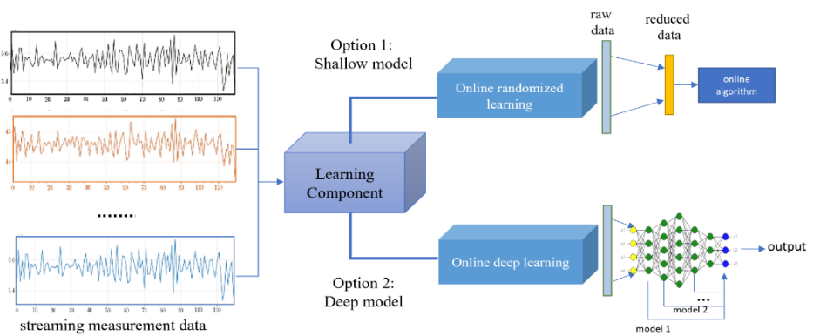

Virtual Meter for Active Distribution Systems
Funded by NSF, 2019-2022
WSU-PI: Saeed Lotfifard
This project will develop a virtual meter to address the problem of lack of observability in active distribution systems using a co-modeling of data driven models and physics-based models

Slide 26
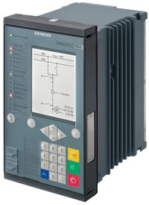
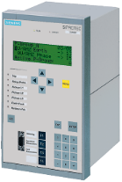
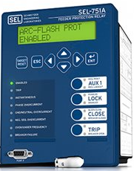
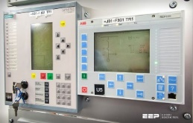
Situational Awareness: Root Cause Analysis
Funded by NSF, 2019-2024
Co-PI: Saeed Lotfifard
This project will develop a method for robust identification of root cause in presence of protection failures and data loss

Slide 27
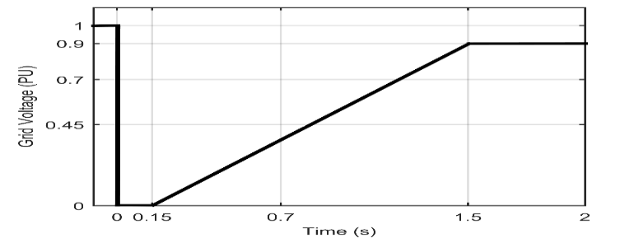
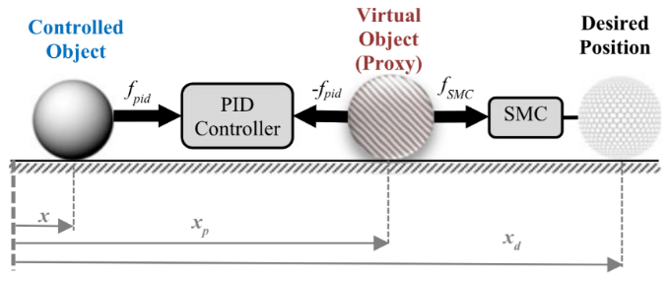
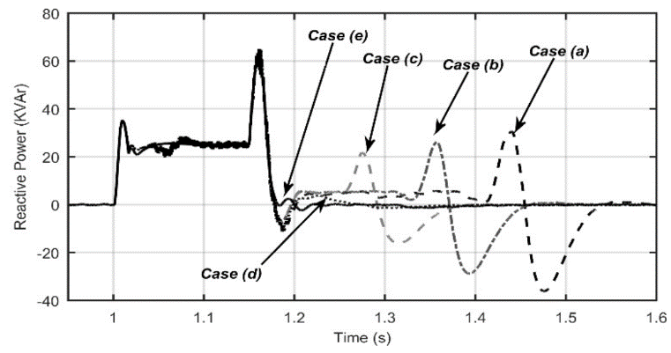

Fault Resilient Inverters
Funded by PSERC, 2020-2022
WSU-PI: Saeed Lotfifard
This project will develop methods for enhancing fault ride through (FRT) capability of inverter-interfaced resources
Type 1 Limit
Type 2 Limit
Must Remain Connected
Disconnection Permitted
Graphical illustration of PBSMC.

Slide 28


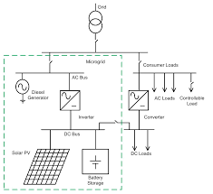

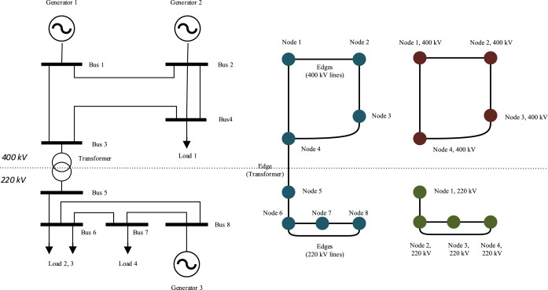
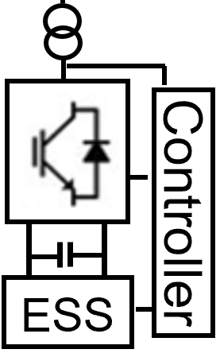

Identification and Mitigation of Operational Security of Inverter Dominated Power Grids
Funded by PSERC, 2021-2023
WSU-PI: Saeed Lotfifard
This project will identify operational security vulnerabilities that grid integration of massive amounts of inverter-based resources creates. Specifically, protection systems responses and grid synchronism stability of inverters will be analyzed and mitigation strategies will be developed
Transmission
Distribution

Slide 29
Challenges and Opportunities
Mani Venkatasubramanian
More intermittent renewable energy sources
Increased exposure to climate change events and adversarial threats
Flexible loads and flows on the edge
Smart controls and fast communication networks
Stability Analysis and Adaptive Controls
Real-time Sensor Measurements

Slide 30
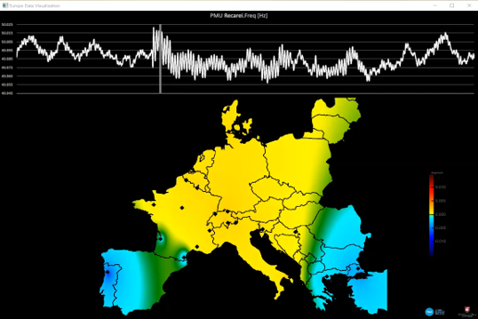
Oscillation Monitoring System for RTE
Mani Venkatasubramanian
PMU based oscillation and modal analysis algorithms
Licensed by RTE French power grid operator
Recently used by RTE for synchronizing Ukraine power grid with European interconnection

Slide 31
Analysis of IBR Models
Mani Venkatasubramanian
2021 Texas Odessa Event
(1100 MW solar trip)
(NERC Report)
What IBR model parameters are critical in influencing bulk power system performance?
What IBR parameters can be estimated from terminal measurements?
What measurements and events are useful?

Slide 32
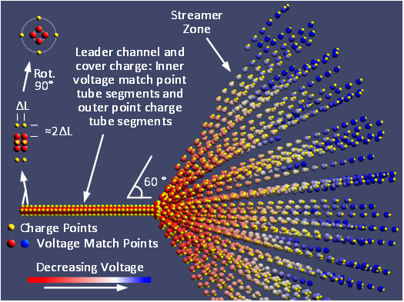
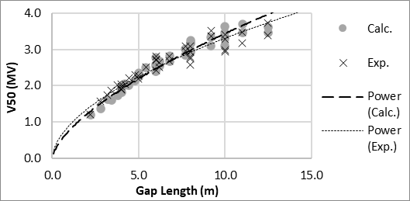
Maximizing Power Transfer of HV Transmission Lines
Bob Olsen
  Electric field spatial distribution as a unifying factor in design
  Modeling corona attenuation of switching surges
  Relation of critical flashover voltage to electric field minimum
    Funded by AEP, Power Engineers and PSERC

Slide 33
Proper Testing Conditions for High Voltage Hardware
Bob Olsen
R. G. Olsen, M. W. Tuominen and J. T. Leman, “On Corona Testing of High Voltage Hardware Using Laboratory Testing and/or Simulation,” IEEE Transactions on Power Delivery, Vol. 33, pp. 1707-1715, August 2018

Slide 34
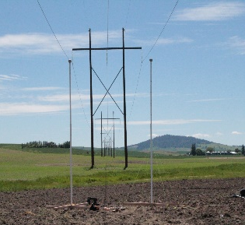
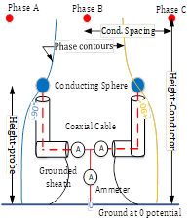
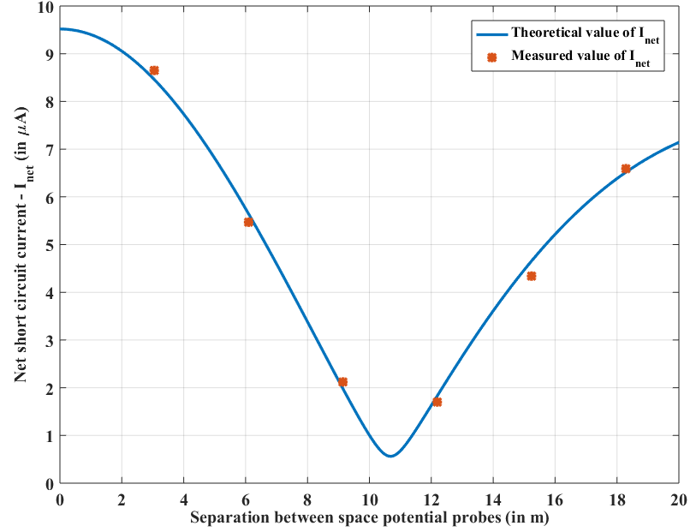
Non-Contact Measurement of Conductor Sag
Bob Olsen
M. Mukherjee, R. G. Olsen, and Z. Li, “Non-Contact Monitoring of Overhead Transmission Lines using Space Potential Phasor Measurements,” IEEE Transactions on Instrumentation and Measurement, Vol 69, No. 10, pp- 7494-7504, October 2020

Slide 35
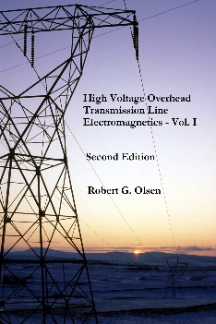
Free Download
Bob Olsen
Real high voltage overhead transmission lines
Propagation on single conductor transmission line above earth.
Electromagnetic fields surrounding a single conductor transmission line
Brief overview of numerical techniques for electrostatics
Propagation on multiconductor transmission line above earth
Limitations on power carrying capacity of transmission lines
Physics of corona onset and corona effects
Electromagnetic compatibility with the environment and/or other systems
Measurements
Electric/magnetic fields of high voltage transmission lines
Grounding issues
http://eecs.wsu.edu/~olsen/Book_Files

Slide 36

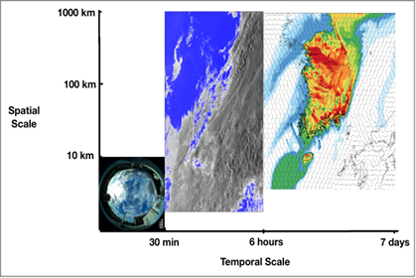
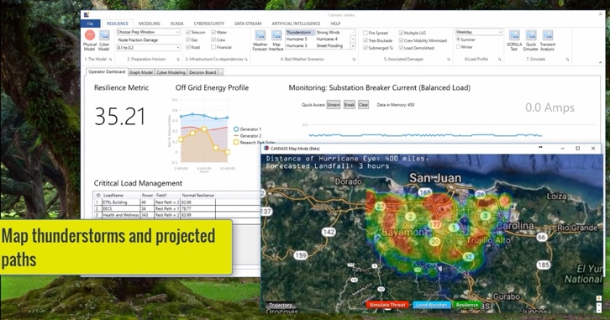
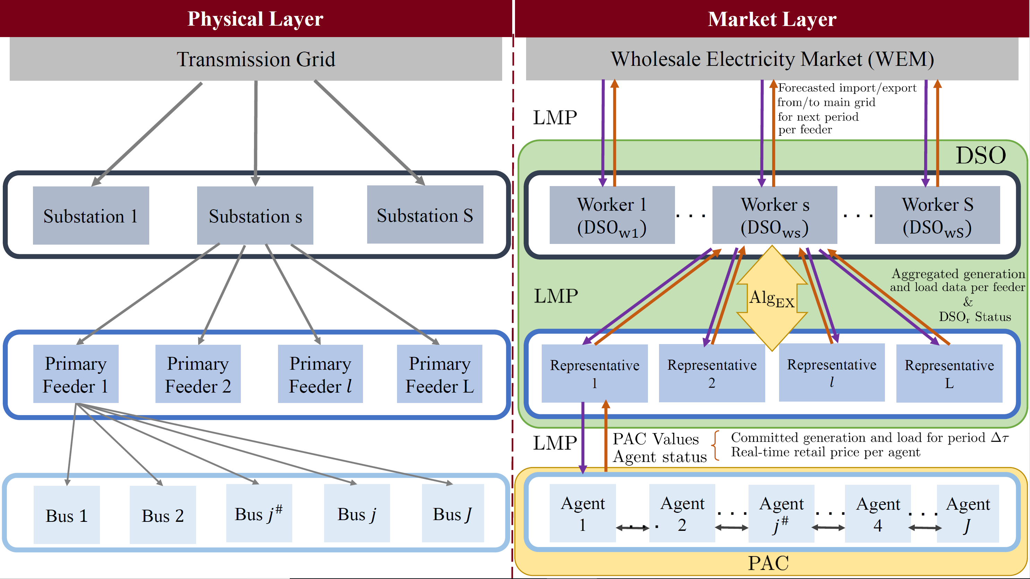
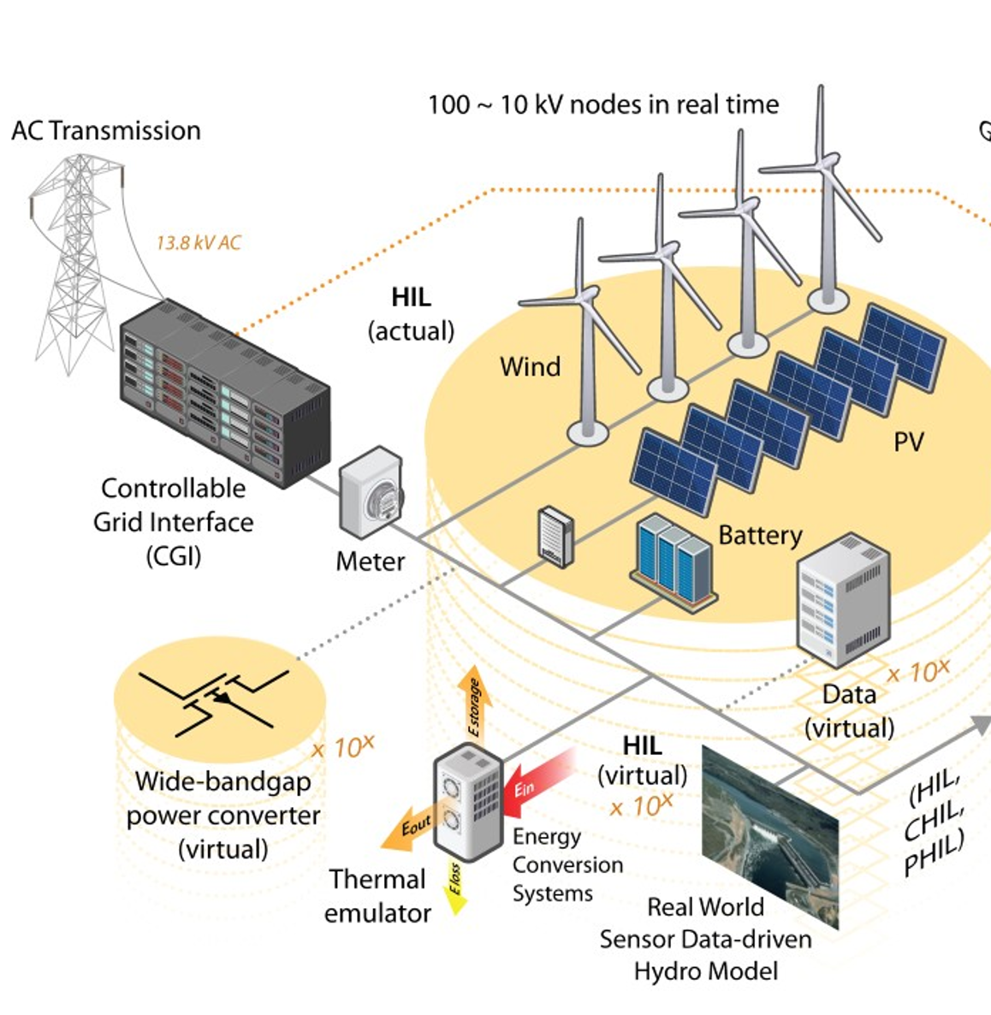
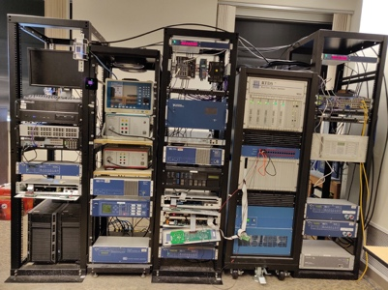
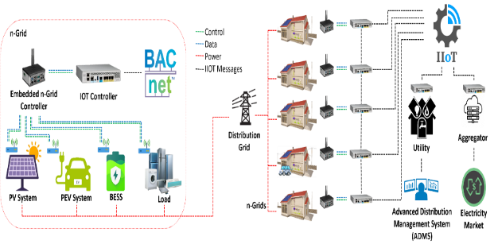

UI ASSIST Project Outcomes- A Smart Distribution System
Noel Schulz, Sanjeev Pannala, Anjan Bose, Assefaw Gebremedhin and Christine Horne
$30.0 M Project with 15 US and 15 India Partners including National labs, Utilities and Industry Vendors
Benchmarking feeders and storage models
Resiliency tools
Cyber-Physical interdependency analysis framework
Next-generation data utilization techniques
  Load forecasting, BTM DER estimation
  ML/Physics driven-Event analytics using measured data
  Volt-Var Scheme, Reconfiguration schemes
Distribution market models
Operation and control of MGs/Aggregated DERs/ Nanogrids
  Protection schemes, Inverter controls
  Cluster of microgrids operation
US-India federated laboratory setup
US-India Policy comparison and key recommendations
Actual technology adoption and field pilot demonstrations
Workforce advancements- Trainings and online workshops
PV forecasting web tool: HNEI
R-PIA tool: WSU
NREL-WSU Federated testbed
Retail Market: MIT
https://uiassist.org/
Transactive Control n-grids: TAMU

Slide 37




WSU-PNNL AGI Alternate Generation Study for PNW
Noel Schulz, Anjan Bose, Jeffery Dagle (PNNL) and Sanjeev Pannala
Compelling Issues & Challenges
  Regional observations building on NASEM report
  Consider State and Federal policies and goals
  Review utilities’ integrated resource plans
Identified major issues in Pacific Northwest (PNW) region
Analyzed the current generation mix from utilities in PNW
Looking at State level challenges
Replacement of Coal plants with alternate resources
White paper on clean power grid challenges
Key recommendations to address the issues
https://natlab.wsu.edu/grid/

Slide 38
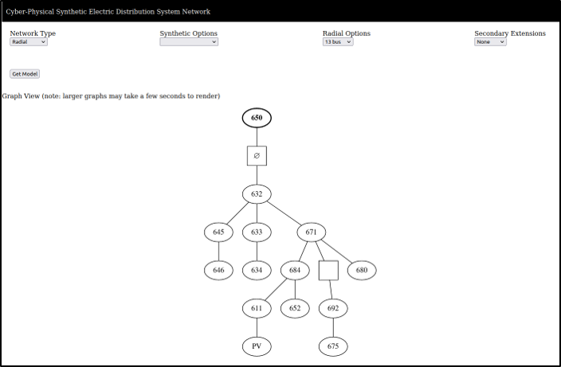

Examples of CS Activities Related to Power Grids
Assefaw Gebremedhin
CP-SyNet
  Tool for generating customized cyber-power synthetic network for distribution systems with DER
  UI-ASSIST effort
CySER Institute
  NW Institute for Cybersecurity Education & Research
  Funded by DOD
GAANN Program
  AI & Data Science for complex
  engineering applications (power grid, SE)
  Six PhD Fellowships
  Funded by Dept of Education
https://cp-synet.scads.eecs.wsu.edu/
https://cyser.wsu.edu/

Slide 39
Advanced Grid Institute (AGI) Update
Mr. Jeff Dagle
(AGI/PNNL)
AGI Co-Director

Slide 40
NSF Innovations Engine INTENT Proposal Overview
Mr. John Gibson
(Avista)

Slide 41
Roundtable Discussion
and Wrap-up
All In Attendance

Slide 42
Adjourn
THANK YOU!

